Slide 1

SDLC
Planning Stage

Slide 2
The planning stage
The planning stage of SDLC is dedicated to preparing the groundwork for the project.
The primary areas of the planning stage are:
Assessing the solution in relation to the customer and the business
Determining the feasibility of a project
Defining the scope and Requirements of the project

Slide 3
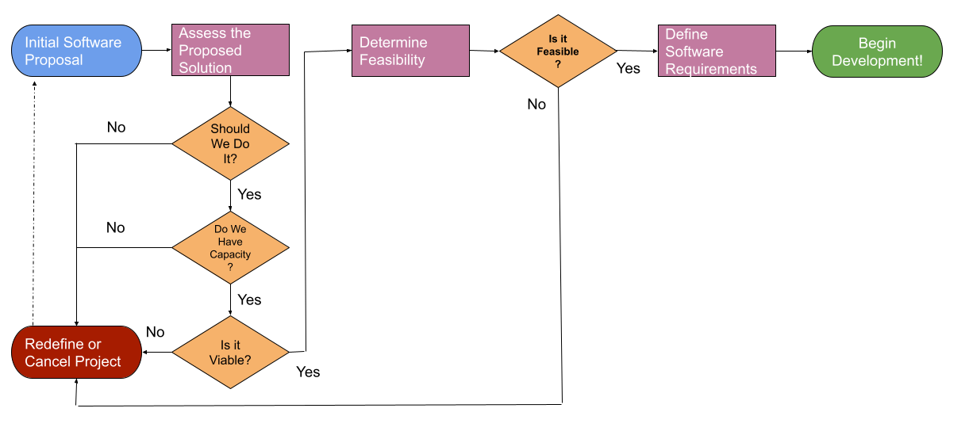
SDLC Planning Phase

Slide 4
Assessing the value of the solution
The first step is evaluating whether creating the solution will:
Provide value to the Customer
Provide value to the Business
Is actually accomplishable
To determine this we’ll ask ourselves a few questions

Slide 5
Question 1: should we do it?
Once receiving the client brief, your software company should begin by asking: Is the business problem clear enough and can it likely be solved using technology?
Initial discussions with customers generally reveal two different realizations
They have a problem you can possibly solve successfully with technology, or
They have a problem you don’t understand or cannot be solved by technology
In the second realization, you have to be strong enough to say NO, you cannot proceed with an engagement until you have the potential to reach a successful outcome

Slide 6
Can it be solved with Technology?
Characteristics of a problem that is NOT solvable with IT:
Client goal is nebulous, vague, or unrealistic
The problem is exclusively human-based
Characteristics of a problem that is solvable with IT:
You understand the problem the client is facing or the goal they want to achieve
Customer names the technology they want you to implement

Slide 7
Example 1
Customer says they take orders in store but would like to be able to take orders online
Is this sufficient information that a solution is attainable?

Slide 8
Example 2
A restaurant owner says they want to break into the online jewelry sales and want an application written for that.
Is this sufficient information that a solution is attainable?

Slide 9
Example 3
The customer says they need to train employees regularly on safety, as required by government regulations, and would like you to build a website for them to facilitate the creation and delivery of training
Is this sufficient information that a solution is attainable?

Slide 10
Example 4
A customer says their employee turnover is high. Can you implement a solution to reduce this?
Is this sufficient information that a solution is attainable?

Slide 11
Example 5
A Customer says they want to create an application that will revolutionize travel.
Is this sufficient information that a solution is attainable?

Slide 12
Question 2: do we have capacity?
Does the company have enough resources to take on this new project?
Are there currently enough developers to work on this? Do they have enough time?
Are there other resources required? Can we acquire them?

Slide 13
Is it Viable?
What other potential reasons do we have for selecting to do this project?
Who would decide?

Slide 14
Question 3: Is it viable?
Various other criteria can also go into deciding the viability of a new project (especially internal projects), such as
Return on Investment (ROI)
Improving Operations (Efficiency, Savings)
Legal Requirements
Seniority of the person requesting said project
Increased Employee or Customer Satisfaction
Risk Reduction (patching old software, securing data, etc)

Slide 15
SDLC Planning Phase

Slide 16
Determine the feasibility of a project
Assuming a project has made it past the initial filters, it is then looked at to determine whether the business can actually accomplish it
This is a “Feasibility Study” (may also be known as a “Business Case” or “Risk Analysis”)

Slide 17
Technical Feasibility
To determine the technical feasibility of a project, a business needs to look at:
Its familiarity with the application
Its familiarity with the technologies involved
Review the size of the project
Check the solution’s compatibility with existing systems

Slide 18
Organizational feasibility
To determine the organizational feasibility of a project, a business needs to look at:
What do the project stakeholders think?
Senior management
Software Architect
The Subject Matter Experts
The Quality Assurance Officer
Can it be done?
Does it align with the business vision?

Slide 19
Economic Feasibility
To determine the economic feasibility of a project, a business needs to look at:
Development Costs
Annual Operating Costs
Return on Investment
Break-Even period
Intangible Costs and benefits

Slide 20
Defining Scope and Requirements
Assuming the project passes the feasibility study you are ready to fully outline what you are building
This outline is called the “Software Requirements Specification” (SRS)
In the SRS we will capture the following:
The purpose
The Scope
Any specific Requirements

Slide 21
Why create an SRS Document?
This document is the true foundation for your entire project
It’s used to provide critical information to every team on the project
Development
Quality Assurance
Operations
Maintenance
It is the single source of truth the rest of the project stems from
For the reasons above, it saves development time and cost

Slide 22
What’s captured in an srs?
Introduction
Scope
Definitions and Acronyms
Project Overview
User Needs
Assumptions and Dependencies
Specific Requirements
Functional Requirements
Interface Requirements
Nonfunctional Requirements

